Slide 1
Transport management system
name:Varshini hc
Submitted on:15/07/2024

Slide 2



Introduction to Roamhub
Roamhub is the study of planning, organizing, and overseeing the travel and hospitality industry. It encompasses everything from destination development to marketing and operations. Understanding the complexities of this dynamic field is crucial for anyone aspiring to a career in tourism.

Slide 3
Understanding the Tourism Industry
Sectors
Stakeholders
Trends
Tourism is composed of various interdependent sectors, including transportation, accommodation, food and beverage, attractions, and travel agencies.
Key stakeholders in tourism include tourists, local communities, businesses, governments, and environmental organizations.
Emerging trends like sustainable tourism, adventure travel, and the rise of digital platforms are shaping the industry.

Slide 4

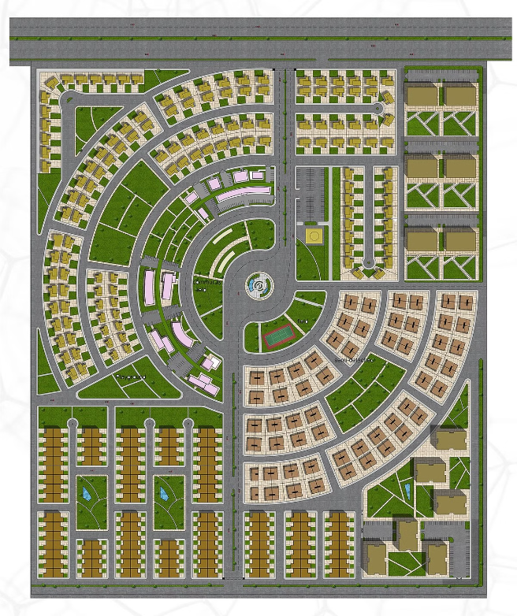
Destination Planning and Development
1
Assessment
Analyzing a destination's resources, infrastructure, and market potential to determine its viability.
2
Strategic Planning
Developing a comprehensive plan to guide the sustainable growth and management of the destination.
3
Implementation
Executing the plan through infrastructure improvements, marketing initiatives, and community engagement.

Slide 5


Sustainable Tourism Practices
1
Environmental Responsibility
Minimizing the ecological footprint of tourism activities and preserving natural resources.
2
Cultural Sensitivity
Respecting and promoting the authentic cultural heritage of host communities.
3
Economic Empowerment
Ensuring that tourism benefits local economies and improves the livelihoods of residents.
4
Stakeholder Collaboration
Fostering partnerships between industry, government, and communities to achieve sustainable outcomes.

Slide 6


Tourism Marketing and Branding
Destination Branding
Crafting a unique and compelling brand identity to differentiate a destination in the global market.
Digital Strategies
Leveraging digital platforms and social media to reach and engage with target audiences.
Personalized Experiences
Curating tailored tourism products and services to meet the evolving needs and preferences of travelers.
Responsible Promotion
Promoting destinations in a way that balances tourism growth with environmental and cultural preservation.

Slide 7


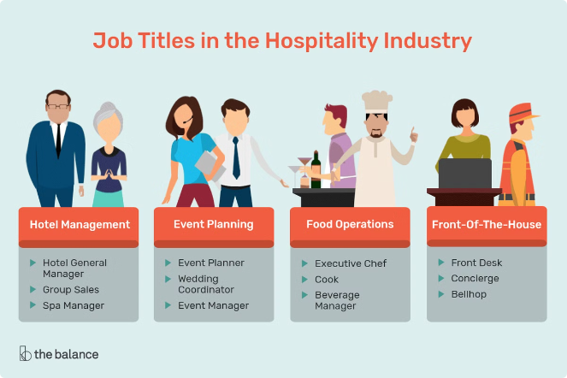



Tourism Operations and Management
Customer Service
Providing exceptional experiences that exceed guest expectations.
Revenue Management
Optimizing pricing and inventory to maximize profitability.
Risk Management
Identifying and mitigating potential operational risks and disruptions.
Quality Assurance
Maintaining high standards of service and product delivery.

Slide 8





Hospitality and Accommodation Management
Guest Experience
Designing and delivering exceptional guest experiences that exceed expectations.
Operational Efficiency
Optimizing resource utilization and streamlining processes for operational excellence.
Revenue Maximization
Implementing effective revenue management strategies to drive profitability.

Slide 9


Emerging Trends and Challenges in Tourism
Overtourism
Managing the impact of growing visitor numbers on destinations.
Technological Disruption
Adapting to the rapid evolution of digital technologies in the industry.
Sustainability Concerns
Balancing tourism growth with environmental and social responsibility.
Changing Consumer Preferences
Catering to the evolving needs and expectations of modern travelers.

